Slide 1
Machine Learning
Google Colab Tutorial
TA : 許湛然（Chan-Jan Hsu）
2021.03.05

Slide 2
Introduction
Colaboratory, or "Colab" for short, allows you to write and execute Python in your browser, with
Zero configuration required
Free access to GPUs
Easy sharing

Slide 3
Introduction
Colab Demo : https://reurl.cc/ra63jE
In this demo, your will learn the following :
Download files using colab
Connect google colab with your google drive
Pytorch examples and common errors

Slide 4
Introduction
You can type python code in the code block, or use a leading exclamation mark ! to change the code block to treating the input as a shell script
import numpy
import math python
…
!ls -l
shell script

Slide 5
Introduction
Exclamation mark (!) starts a new shell, does the operations, and then kills that shell, while percentage (%) affects the process associated with the notebook, and it is called a magic function.
Use % instead of ! for cd(change directory) command

Slide 6
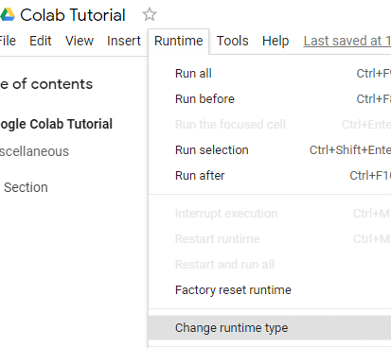
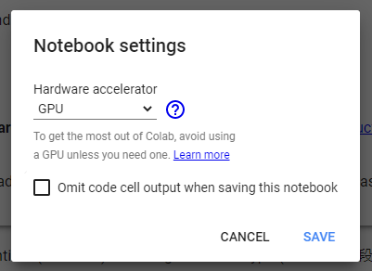
Changing Runtime
To utilize the free GPU provided by google, click on "Runtime"(執行階段) -> "Change Runtime Type"(變更執行階段類型). There are three options under "Hardware Accelerator"(硬體加速器), select "GPU".
* Doing this will restart the session, so make sure you change to the desired runtime before executing any code.

Slide 7
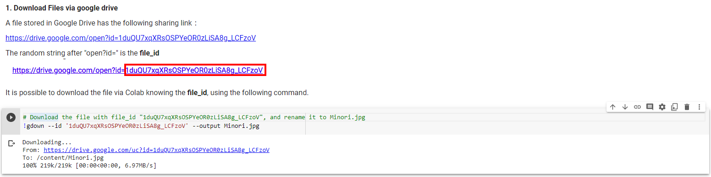
Executing Code Block
Click on the play button to execute the code block. This code downloads a file from google drive

Slide 8
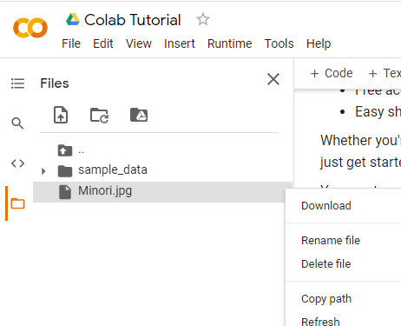
File Structure
Clicking on the folder icon will give you the visualization of the file structure
There should be a jpg file, if you do not see it, click the refresh button
The file is temporarily stored, and will be removed once you end your session. You can download the file to your local directory.
refresh

Slide 9
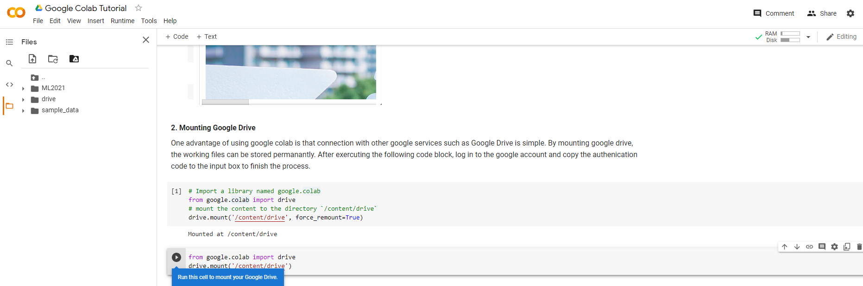
Mounting Google Drive
Execute the code block with drive.mount(‘/content/drive’)
or click on the Google Drive icon, a code block will appear

Slide 10
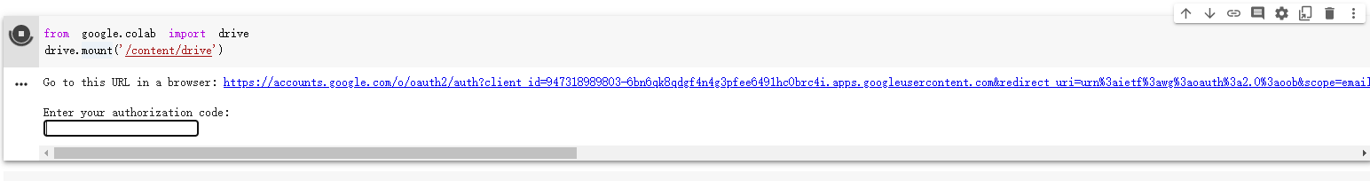
Mounting Google Drive
Sign in to your google account to get the authorization code. Enter the authorization code in the box below.

Slide 11
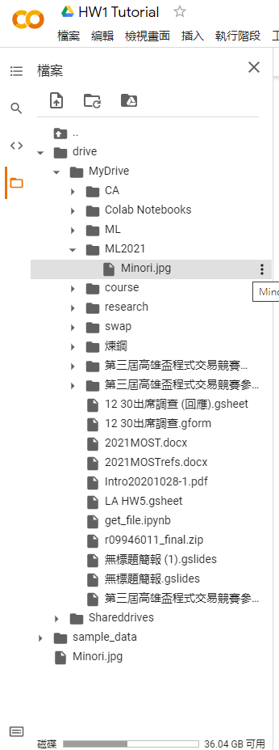
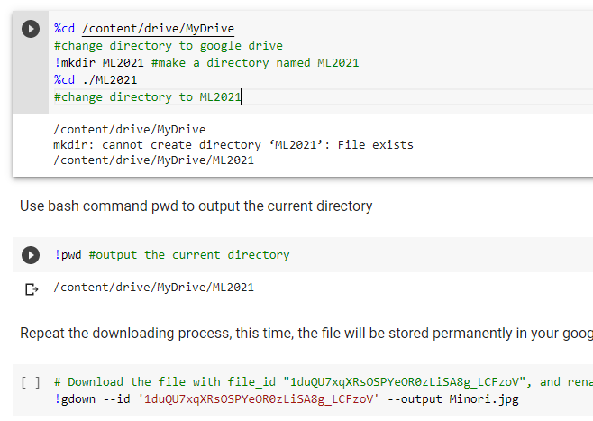
Mounting Google Drive
Execute the following three code blocks in order
This will download the image to your google drive, so you can access it later

Slide 12
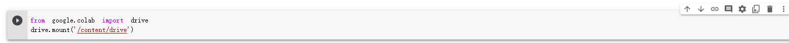
Moving and Creating a New Code Block
You can create a new code block by clicking on +Code(程式碼) on the top
Move cell up
Move cell down
Delete cell

Slide 13
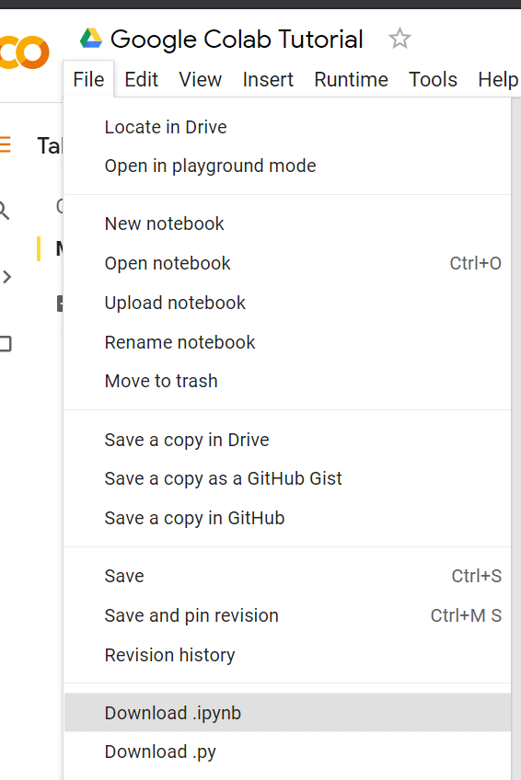
Saving Colab
You can download the ipynb file to your local device ( File > Download .ipynb), or save the colab notebook to your google drive (File > Save a copy in Drive).

Slide 14
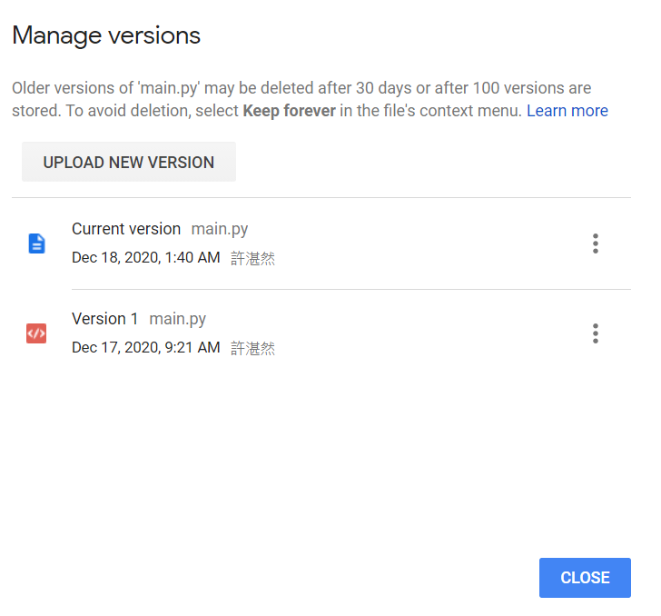
Recovering Files in Google Drive
Right Click on File > Manage Versions (版本管理) to recover old files that have been accidentally overwritten.

Slide 15
Useful Linux Commands (in Colab)
ls : List all files in the current directory
ls -l : List all files in the current directory with more detail
pwd : Output the working directory
mkdir <dirname> : Create a directory named <dirname>
cd <dirname> : Move to directory named <dirname>
gdown : Download files from google drive
wget : Download files from the internet
python <python_file> : Executes a python file

Slide 16
Machine Learning
Pytorch Tutorial 2
Documentation and Common Errors
TA : 許湛然（Chan-Jan Hsu）
2021.03.05

Slide 17
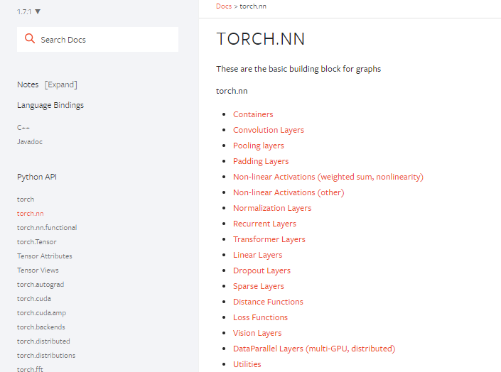
PyTorch Documentation
https://pytorch.org/docs/stable/
torch.nn -> neural network
torch.optim -> optimization algorithms
torch.utils.data -> dataset, dataloader

Slide 18
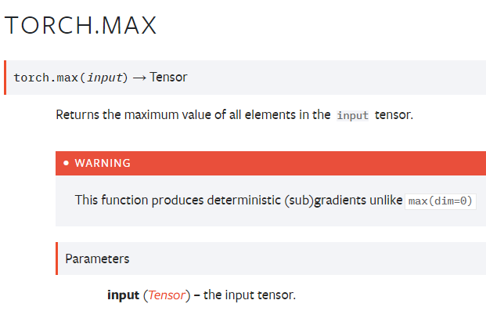
PyTorch Documentation Example
function inputs and outputs
data type and explanation of each input

Slide 19
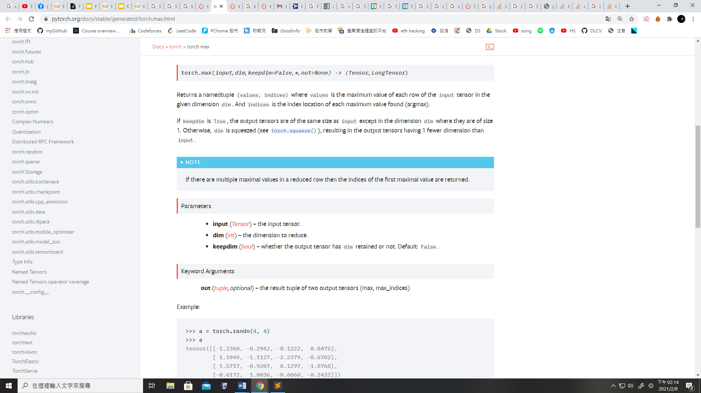
PyTorch Documentation Example
Some functions behave differently with different inputs
Parameters : You don’t need to specify the name of the argument
(Positional Arguments)
Keyword Arguments : You have to specify the name of the argument
They are separated by *

Slide 20
PyTorch Documentation Example
Some functions behave differently with different inputs
Arguments with default value :
Some arguments have a default value (keepdim=False), so passing a value of this argument is optional

Slide 21
PyTorch Documentation Example
Three Kinds of torch.max
torch.max(input) → Tensor
torch.max(input, dim, keepdim=False, *, out=None) → (Tensor, LongTensor)
torch.max(input, other, *, out=None) → Tensor
input : Tensor, dim : int, keepdim : bool
other : Tensor

Slide 22
PyTorch Documentation Example
1.torch.max(input) → Tensor
Find the maximum value of a tensor, and return that value.

Slide 23
PyTorch Documentation Example
2. torch.max(input, dim, keepdim=False, *, out=None) → (Tensor, LongTensor)
Find the maximum value of a tensor along a dimension, and return that value, along with the index corresponding to that value.

Slide 24
PyTorch Documentation Example
3.torch.max(input) → Tensor
Perform element-wise comparison between two tensors of the same size, and select the maximum of the two to construct a tensor with the same size.

Slide 25
PyTorch Documentation Example (Colab)
Three Kinds of torch.max
torch.max(input) → Tensor
torch.max(input, dim, keepdim=False, *, out=None) → (Tensor, LongTensor)
torch.max(input, other, *, out=None) → Tensor
input : Tensor
dim : int
keepdim : bool
other : Tensor
Colab code
x = torch.randn(4,5)
y = torch.randn(4,5)
m = torch.max(x)
m, idx = torch.max(x,0)→O
m, idx = torch.max(input = x,dim=0)→O
m, idx = torch.max(x,0,False)→O
m, idx = torch.max(x,0,keepdim=True)→O
m, idx = torch.max(x,0,False,out=p)→O
m, idx = torch.max(x,0,False,p)→x
*out is a keyword argument
m, idx = torch.max(x,True)→x
*did not specify dim
t = torch.max(x,y)

Slide 26
Common Errors -- Tensor on Different Device to Model
model = torch.nn.Linear(5,1).to("cuda:0")
x = torch.Tensor([1,2,3,4,5]).to("cpu")
y = model(x)
Tensor for * is on CPU, but expected them to be on GPU
=> send the tensor to GPU
x = torch.Tensor([1,2,3,4,5]).to("cuda:0")
y = model(x)
print(y.shape)

Slide 27
Common Errors -- Mismatched Dimensions
x = torch.randn(4,5)
y = torch.randn(5,4)
z = x + y
The size of tensor a (5) must match the size of tensor b (4) at non-singleton dimension 1
=> the shape of a tensor is incorrect, use transpose, squeeze, unsqueeze to align the dimensions
y = y.transpose(0,1)
z = x + y
print(z.shape)

Slide 28
Common Errors -- Cuda Out of Memory
import torch
import torchvision.models as models
resnet18 = models.resnet18().to("cuda:0") # Neural Networks for Image Recognition
data = torch.randn(512,3,244,244) # Create fake data (512 images)
out = resnet18(data.to("cuda:0")) # Use Data as Input and Feed to Model
print(out.shape)
CUDA out of memory. Tried to allocate 350.00 MiB (GPU 0; 14.76 GiB total capacity; 11.94 GiB already allocated; 123.75 MiB free; 13.71 GiB reserved in total by PyTorch)
=> The batch size of data is too large to fit in the GPU. Reduce the batch size.

Slide 29
Common Errors -- Cuda Out of Memory
If the data is iterated (batch size = 1), the problem will be solved. You can also use DataLoader
for d in data:
out = resnet18(d.to("cuda:0").unsqueeze(0))
print(out.shape)

Slide 30
Common Errors -- Mismatched Tensor Type
import torch.nn as nn
L = nn.CrossEntropyLoss()
outs = torch.randn(5,5)
labels = torch.Tensor([1,2,3,4,0])
lossval = L(outs,labels) # Calculate CrossEntropyLoss between outs and labels
expected scalar type Long but found Float
=> labels must be long tensors, cast it to type “Long” to fix this issue
labels = labels.long()
lossval = L(outs,labels)
print(lossval)

